Slide 1
ECONOMIC SYSTEM
How a society produces
and distributes goods and services

Slide 2
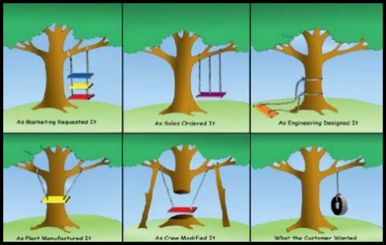
Three Key Economic Questions:
What goods and services
will be produced?
How will these goods and
services be produced?
Who will consume these
goods and services?
Humor in Product Design

Slide 3
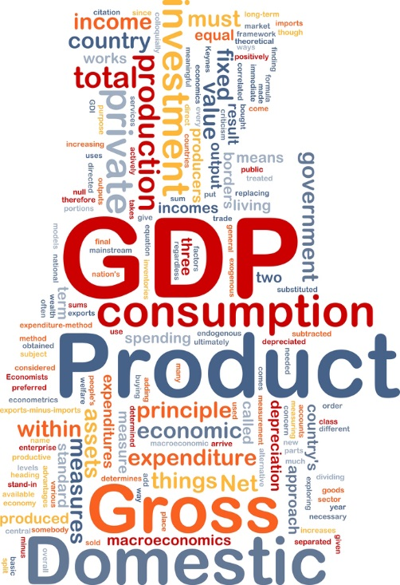
What should be produced?
Food
Shelter
National Defense
Heavy Industry
Education
Public Health and Welfare
Consumer Goods
????

Slide 4
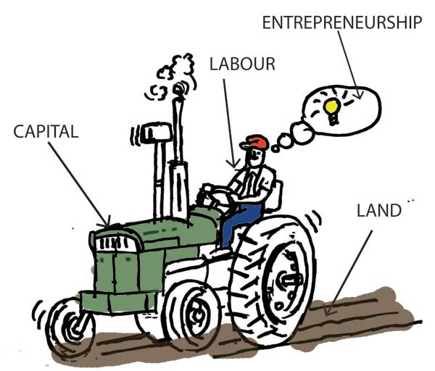
How should goods and services be produced?
What resources will be used?
Do we make electricity with coal, oil, natural gas, wind, solar, or nuclear?
Do we deliver education online
or in classes with teachers?
Do we grow food on large corporate
farms or small organic farms?
All the stuff we need requires
land, labor, and capital-
the factors of production…

Slide 5
Who consumes goods and services?
Our economic output is staggering in size,
but the quantities are not unlimited!
How does this abundance get divided up? This depends on how a society’s income is distributed. Factor payments are the income people receive for supplying the factors of production: land, labor, human and physical capital, and entrepreneurship.
The question of who gets to consume which goods and services depends on the social values and goals of a society.

Slide 6
Economic Goals
Economic Efficiency: Making the most of scarce resources
Economic Freedom: Freedom from government intervention in the production of goods and services
Economic Security and Predictability: Assurance that goods and services will be available, payments will be made on time, and a safety net will protect individuals in times of general or personal economic crisis.
Economic Growth and Innovation: Innovation leads to economic growth, and economic growth leads to a higher standard of living.
Other Goals: Economic equity or fairness, environmental protection, civil rights, universal medical care, etc.

Slide 7
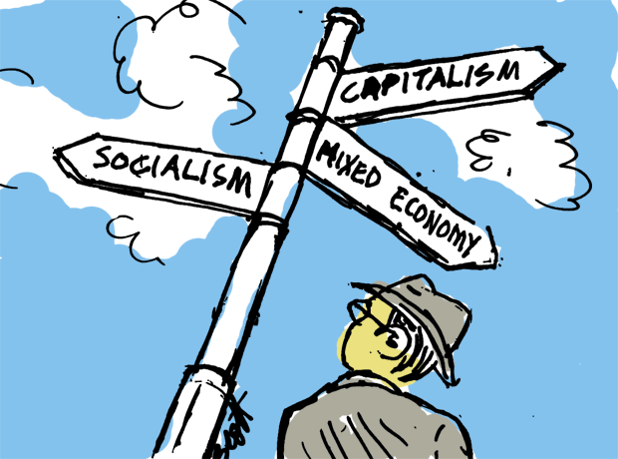
Four Economic Systems
These following systems address the
three economic questions:
Traditional Economy, which relies on customs and rituals.
Market Economy, in which individuals make decisions based on trade free of government intervention.
Command (or Centrally Planned) Economy, in which a central government answers the economic questions.
Mixed Economy, which have a mixture of free markets and government involvement. Most modern economies are of this type.

Slide 8
Traditional Economy!

Slide 9
The Traditional Economy
Based on custom or ritual, with little room for innovation or change
Revolves around the family with work divided along gender lines
Tends to stay small & close, people work to support entire community
Agricultural and hunting practices often lie at the heart of people’s lives, laws, and religious beliefs
Tend to resist change and remain stagnant, thus slow to adopt new ideas and technology
Poor access to modern goods and services, with difficulty dealing with effects of environmental disaster.

Slide 10
The FREE MARKET Economy

Slide 11
Free Market Economy
Voluntary exchange of money and products in markets.
Markets exist because no one is self-sufficient. They allow us to trade or exchange things we have for what we want.
Each one of us tends to produce just one or a few products. This concentration of productive forces on a limited number of activities is known as specialization.
Because we specialize in producing a few things, we need markets to sell what we have and buy what we want.
In a free market system, individuals and businesses own the factors of production, make what they want, and buy what they want…

Slide 12
Free Market- Individuals and Privately-Owned Businesses Own the Factors of Production
Circular flow diagram shows how individuals and businesses exchange money, resources, and products in the marketplace.
The players:
Households- people living in same residence; they are the owners of the factors of production- land, labor, and capital.
Firms- business organizations that transform the factors of production into products.
Factor market- firms pay households for land, labor, and capital.
Product market- households pay firms for goods and services

Slide 13
Circular Flow Diagram or Model

Slide 14
Marketplace is Self-Regulating
It functions through competition and individuals acting in self-interest
Self Interest- Adam Smith, in The Wealth of Nations, observed that people are motivated by personal gain. For a market to operate efficiently, private property rights must be enforced by law
Competition- consumers or households have the motivation or incentive to seek the lowest prices. Firms seek to make profits by increasing sales and/or prices. The struggle between consumers and firms is called competition
The Invisible Hand- self-interest and competition work together to regulate the marketplace, all happening without any central plan or direction. The nation’s resources are thus guided to their most productive use. Can you say, “laissez faire”?

Slide 16
Advantages of a Free Market
Economic Efficiency- because it’s self-regulating, a free market responds efficiently to rapid-changing conditions
Economic Freedom- highest degree of freedom of any ststem. Workers work where they want, firms produce what they want, and consumers buy what they want
Economic Growth- with entrepreneurs looking for profitable opportunities, competition encourages innovation and new ideas.
Consumer Sovereignty- consumers effectively decide what gets produced, as producers want to meet consumers’ desires. This leads to a wider variety of goods and services than other systems produce.

Slide 17
No Pure Free Market Exists!

Slide 18
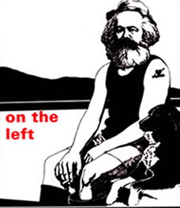
Despite the advantages, a free market has its weaknesses…
Economic fairness and security
are difficult goals to achieve
for many citizens in a free market
system. Also, public goods and
services (like national defense), are
less available because they’re not
profitable. Finally, many firms
are not forced to pay for all the
Costs of producing their products.

Slide 19
Centrally Planned Economy
A central government, not individual producers and consumers in markets, answers the key economic questions of production and consumption. A central bureaucracy collects information, then tells firms what and how much to produce.
Government owns the land and capital,
and controls where labor works and the
wages provided. Free market forces of
self-interest and competition are absent
from the system. There is a lack of
consumer voice or sovereignty in decisions
about what will be produced

Slide 20
Socialism and Communism

Slide 21
Socialism
A social and political philosophy based on the belief that democratic means should be used to distribute wealth throughout a society. Real equality can only exist when political equality is coupled with economic equality. Economic equality is possible only if the public controls the centers of economic power.
Socialist nations may be
democratic, but all require
a high degree of central
planning to achieve
economic equality.

Slide 22
Communism
A political system characterized by a centrally planned economy with all economic and political power resting in the hands of the central government. Unlike socialists, communists think that a communist society can only come after violent revolution. Communist governments are authoritarian, requiring strict obedience from citizens while denying personal freedom. Historically, Communist nations have been dominated by a single political party or dictator.

Slide 23
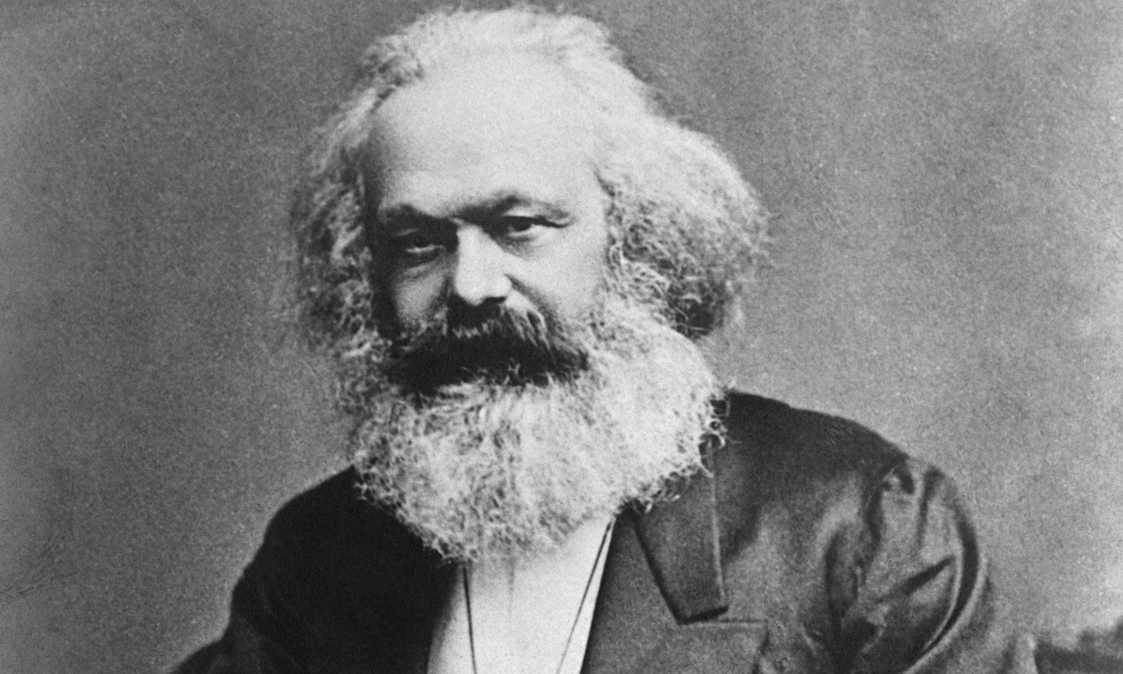
Karl Marx Marxism
A social, political and economic philosophy that examines the effect of capitalism on labor, productivity and economic development. Marxism posits that the struggle between social classes, specifically between the bourgeoisie (capitalists) and proletariat (workers), defines the development of the state, and that the bourgeoisie seek to gain control of the factors of production from the "masses." Only by eliminating the control of the economy from private ownership will the economy continue to grow. (from Investopedia)

Slide 24
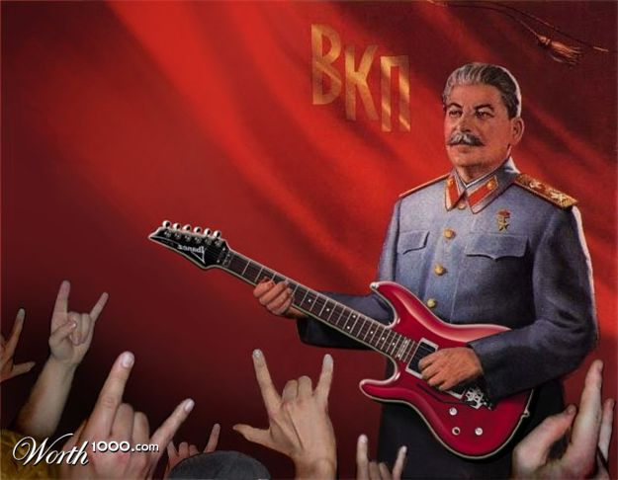
Back in the USSR
Imperial rule in Russia ended after
two revolutions in 1917. Under
control of the Communist Party,
central planning was introduced
in the 1920’s and continued until the
breakup of the Soviet Union in 1991. https://www.youtube.com/watch?v=0VlBuJmgowc
Soviet planners used the best land, labor, and capital for the armed forces, the space program, and the production of capital goods like farm equipment and factories. “Committees” were responsible for the amount, method of production, and distribution of 24 million different goods and services!

Slide 25
Union of Soviet Socialist Republics (USSR)

Slide 27
Sputnik

Slide 28
The Politburo

Slide 32
Soviet Agriculture
Large state-owned farms and “collectives” provided most agricultural production. The state provided all seeds, fertilizer, and equipment; farm wages were set by state planners.
Collectives were large farms leased from the state by groups of peasants. Farmers were required to produce what the government instructed them to, and received a share of the production or a set income. Workers were guaranteed employment, while the gov’t established production quotas. Under this system, people had few incentives to produce more or better crops. Formerly a wheat exporter, the USSR could not feed its own people.

Slide 33
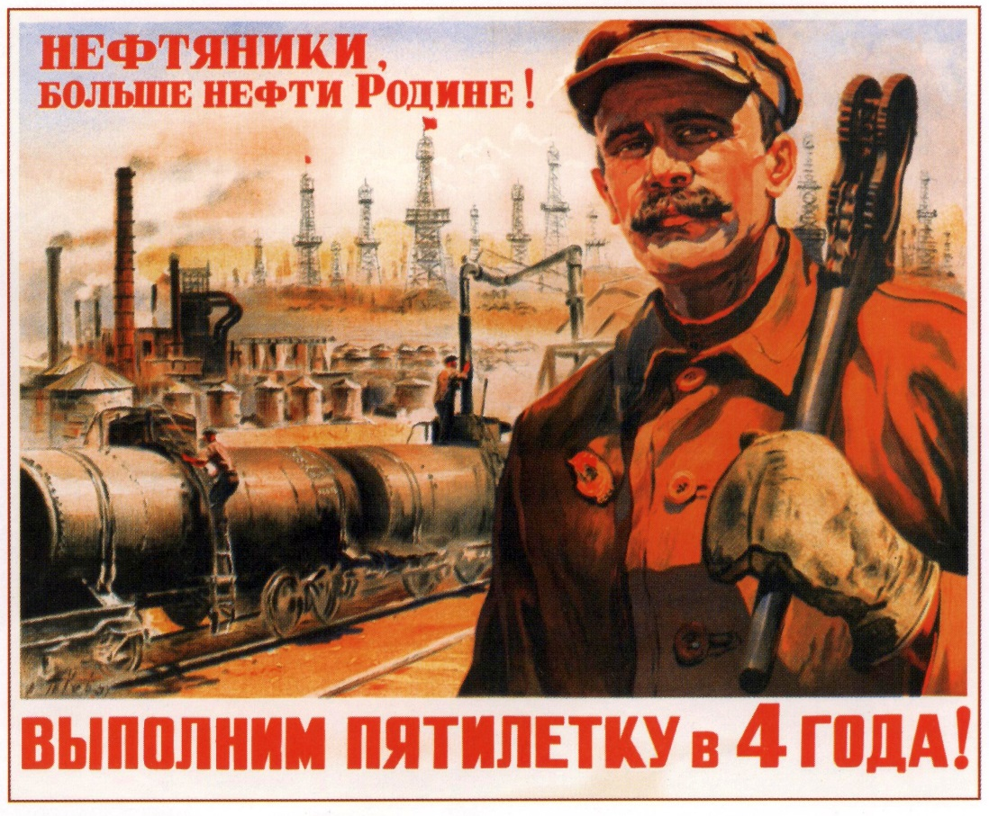
Soviet Industry
With factories also state owned, planners favored the military, the space program, and heavy industry such as chemicals, steel, and heavy machinery. Makers of consumer goods and services were stuck with lower-quality resources to make their products. With jobs and wages set by the government, workers again little incentive to work hard or innovate. Once a production quota was met, there was no reason to produce more. It was illegal for workers to start their own businesses.

Slide 34
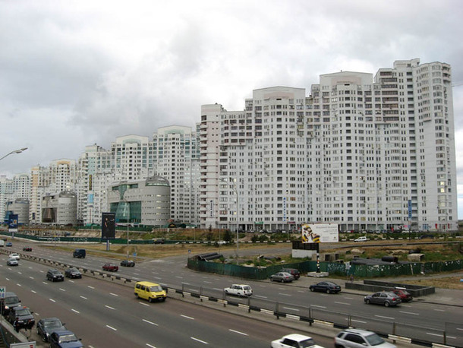
Soviet Consumers
“We pretend to work and they pretend to pay us”
Consumer goods were scarce and usually of poor quality. People had difficulty getting goods, wasting much time in long lines. Luxuries like meat were made affordable by government price setting, but were rarely available.
Due to a shortage
of housing, people often lived
in crowded, poorly constructed
apartments.

Slide 35
Problems of Centrally Planned Economies
Performance falls short of the ideals upon which the system is built
Poor quality of products and services
Serious shortages of non-priority goods and services
Diminishing production levels
Consumer needs and wants not met.
Little incentive for workers to work hard.
Innovation, and therefore change discouraged
Bureaucracy large and expensive and decisions overly complicated
Individual freedoms sacrificed to meet societal goals

Slide 37
Mixed Economy
Has elements off traditional, command, and market economies
Most common type of economic system
Even the most market-based economies have elements of
central planning
Government purchases land, labor, and capital in the factor market
Government purchases goods & services in the product market
Households and businesses pay taxes to support government

Slide 39
The degree of government intervention varies among nations also, see 2005 Economics, Pg. 41

Slide 40
The United States (boy are we mixed!)
The market economy with private property rights dominates in the USA, but the government has much involvement in the economy. 2013 Economics, Pg. 58
Examples: roads, schools, national defense, police and fire protection, government-owned utilities (as in Tallahassee), Social Security, Medicare & Medicaid, food stamps, Pell Grants, the minimum wage, regulations on air and water quality, etc.
https://wetheeconomy.com/films/your-tax-dollars-at-work/
More and more, the USA is part of a global economy, where trade in world markets is vital to our national interests. Globalization has been facilitated by advanced communication & transport systems

Slide 41
International Trade Agreements
North American Free Trade Agreement (NAFTA)
Signed by President Clinton in 1994, this agreement between Canada, Mexico, and the United States, creates a trilateral rules-based trade bloc in North America
Trans-Pacific Partnership Free Trade Agreement (TPP)
The TPP is a proposed free-trade agreement that would open up markets in Asia to the United States, and create new rules for all of these countries to operate under when trading with each other.
Transatlantic Trade and Investment Partnership (TTIP)
The TTIP is another proposed free trade agreement between the USA and the European Union
See http://www.npr.org/sections/goatsandsoda/2014/09/15/345540221/philip-morris-sues-uruguay-over-graphic-cigarette-packaging
https://wetheeconomy.com/films/globalization-who-cares-you-do/?autoplay=yes

Slide 42
Multinational Corporations

Slide 43
Elements that go into the production of cell phones

